Slide 1
NLP Surname Classification - Preprocessing lecture 03.2
Branko Žitko

Slide 2
Contents
Preprocessing

Slide 3
Preprocessing
import collections import numpy as np import pandas as pd from argparse import Namespace
To aid in management of the parameters args object is used to centrally coordinate all preprocessing parameters.
args = Namespace(raw_dataset_csv="surnames.csv", train_proportion=0.7, val_proportion=0.15, test_proportion=0.15, output_munged_csv="surnames_with_splits.csv", seed=1337)

Slide 4
Preprocessing
Raw dataset contains 10980 surnames
# Read raw data surnames = pd.read_csv(args.raw_dataset_csv, header=0) surnames
surname nationality 0 Woodford English 1 Coté French 2 Kore English 3 Koury Arabic 4 Lebzak Russian ... ... ... 10975 Quraishi Arabic 10976 Innalls English 10977 Król Polish 10978 Purvis English 10979 Messerli German [10980 rows x 2 columns]

Slide 5
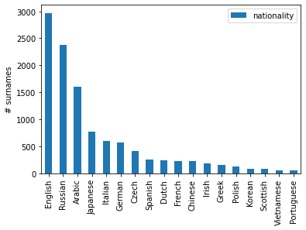
Preprocessing
Distribution of surnames per nationality
# Unique classes pd.DataFrame(surnames.nationality.value_counts()).plot.bar(ylabel="# surnames")

Slide 6
Preprocessing
Reviews are grouped by ratings.
# Splitting train by nationality # Create dict by_nationality = collections.defaultdict(list) for _, row in surnames.iterrows(): by_nationality[row.nationality].append(row.to_dict()) by_nationality
defaultdict(list, {'English': [{'surname': 'Woodford', 'nationality': 'English'}, {'surname': 'Kore', 'nationality': 'English'}, ...]}, ...})

Slide 7
Preprocessing
Splitting to train, validate and test datasets. To each datapoint is added split field that tells if that datapoint is going to be used for training, validating or testing. train_proportion=0.7, val_proportion=0.15, test_proportion=0.15,
# Create split data final_list = [] np.random.seed(args.seed) for _, item_list in sorted(by_nationality.items()): np.random.shuffle(item_list) n = len(item_list) n_train = int(args.train_proportion * n) n_val = int(args.val_proportion * n) n_test = int(args.test_proportion * n) # Give data point a split attribute for item in item_list[:n_train]: item['split'] = 'train' for item in item_list[n_train : n_train + n_val]: item['split'] = 'val' for item in item_list[n_train + n_val:]: item['split'] = 'test' # Add to final list final_list.extend(item_list)

Slide 8
Preprocessing
final_surnames = pd.DataFrame(final_list) final_surnames
surname nationality split 0 Totah Arabic train 1 Abboud Arabic train 2 Fakhoury Arabic train 3 Srour Arabic train 4 Sayegh Arabic train ... ... ... ... 10975 Dinh Vietnamese test 10976 Phung Vietnamese test 10977 Quang Vietnamese test 10978 Vu Vietnamese test 10979 Ha Vietnamese test [10980 rows x 3 columns]
final_surnames.split.value_counts()
train 7680 val 1660 test 1640 Name: split, dtype: int64
# Write munged data to CSV final_surnames.to_csv(args.output_munged_csv, index=False)

